Slide 1
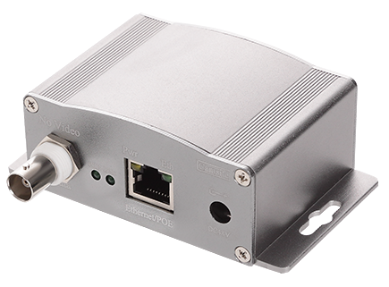
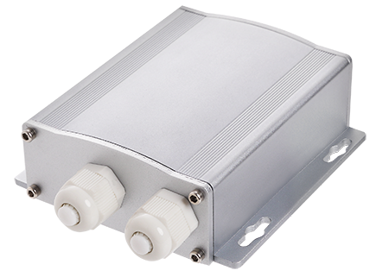
Ethernet/PoE over 2-wire extender
Go farther than your IP camera allows with this IP transmission system

Slide 3
9 FEATURES OF EPOC which make your installation easier
Giga Ethernet bandwidth
Support Giga Bandwidth with long distance transmission via Coaxial Cable or UTP cable and 2-Wire, suitable Ultra High Bandwidth Peer to Peer communication.
1
2
Long distance transmission
Extent Ethernet/PoE signal to 1500 m (4950 feet) via Coaxial Cable or UTP cable and 2-Wire.
3
Daisy Chain configuration
You can connect 4 IP cameras via single coaxial or UTP cable
4
Use any 2-wire cable
EPoC supports any 2-wire cable, including re-use of existing cables, like coax, telephone wire, bell wire, power cable or LAN cable

Slide 4
Encryption
128-bit AES encrypted communication for transient protection
5
Reliability
Built-in Watchdog can auto reconnect when system connection fails
6
7
Multi power source
PoE switch or AC power adapter can be used to supply power
Outdoor application
IP 66 waterproof housing and built-in surge protection make EPoC suitable for use outdoors
8
High Power
Supports PoE or DC12V power output. Maximum support DC12V/4A (50W) power, which suits for IR PTZ Network camera application
9

Slide 5
Say “YES” to EPoC because…
It’s easy to install
EPoC is Plug & Play installation. No IP or MAC address configuration are required
Ultra High data rate
Support Giga Ethernet network bandwidth for Giga Switch Hub to Giga Switch Hub peer to peer communication.
Easy upgrade to IP
Convert existing analog CCTV system over coaxial cable to retrofit analog CCTV installations into IP Digital systems
Rack mount
Supports 19” rack mount of industry

Slide 6
How to use EPoC via UTP cable
Point-to-Point
Daisy Chain

Slide 7
How to use EPoC via Coaxial cable

Slide 8
How to use EPoC via Coaxial cable
Daisy Chain

Slide 9
How to use EPoC via Coaxial cable
Star configuration
9
www.i-view.com.tw

Slide 10
How to use EPoC – High Power DC12V/4A

Slide 11
How to use EPoC – Giga Ethernet Bandwidth

Slide 12
Comparison Chart
Item/Device | EPoC | PoE extender | Fiber Media converter
Cable | Any 2-Wire/Coax | UTP | Fiber optic
Cabling cost | Low | Low | High
Distance | Up to 1500 m | ~100 m | Up to 100 km
PoE for IP camera | Yes | No | No
Installation workability | Easy | Normal | Difficult
Interference | Low | Normal | Low
Transfer speed | High | Normal | High
Configuration | Daisy Chain | Daisy Chain | Point to point
Total System expenses | Low | Normal | High
Maintenance expenses | Low | Normal | High
Engineer adaptability | Easy | Normal | Hard
Total expenses for installation | Low | Normal | High
Conclusion | Best solution | Not reliable | Expensive

Slide 14
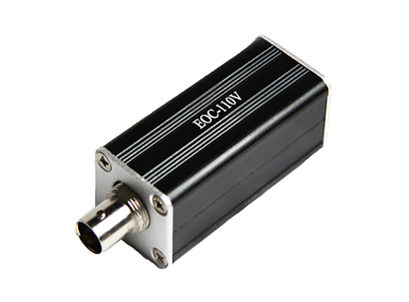
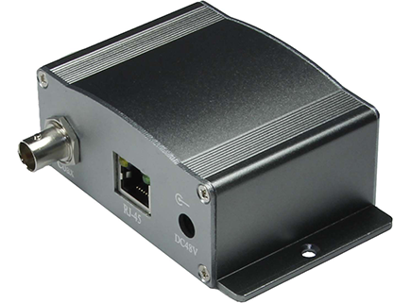
Ethernet over Coax converters
Solve your cabling
problems now

Slide 15
8 FEATURES OF EoC which solve your cabling problems
Ethernet over Coax
Convert Ethernet UTP to transmit network data and PoE over standard coax cable
1
Low cost
EoC-110V surprises you with its low cost but powerful properties
2
High data rate
Support 100 Base-T for high network bandwidth requirements of Mega-pixel cameras or multiple IP cameras
3
4
Easy upgrade to IP
Converts existing analog CCTV system over coaxial cable to retrofit analog CCTV installations into IP Digital systems

Slide 16
5
Extend standard Ethernet
Transmits10/100Base-T up to distances of 250 meters (750 feet)*
Easy to install
No IP or MAC address configuration and other networking setup required
6
7
Save cost and time
Avoids rewiring and expense of traditional Ethernet UTP cable
Compatible capability
Fully transparent to Ethernet networks and higher layer protocols
8

Slide 17
Say “YES” to EoC because…
Save costs on cabling and man power
EoC is a cost-effective device which allows you to save 85% of your total expenses!
Upgrade to IP using existing coax cable
You do not need rewiring as EoC works perfectly with existing coaxial cable to upgrade your analog CCTV
Extent transmission distance up to 250 m
While standard transmission is 100 m only, with EoC you can reach 250 m
IEEE-100Base-T 100 m
EoC (Ethernet over Coax ) 250 m

Slide 18
How to use EoC
www.i-view.com.tw
18

Slide 19
How to use EoC
www.i-view.com.tw
19

Slide 20
Thank you!
I-View Communication Inc.
2F, No.70, Min De Rd, Chutung, 310-48 Hsinchu, Taiwan
sales@i-view.com.tw

